Slide 1
Azure IaaS
Etienne Tremblay - MVP

Slide 2
Agenda
Your services and Azure
Virtual Machines
Virtual Networks
Azure Resource Manager

Slide 3
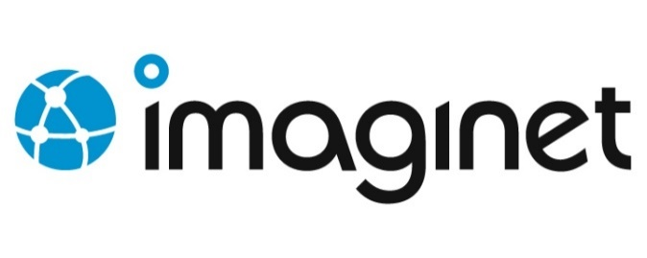

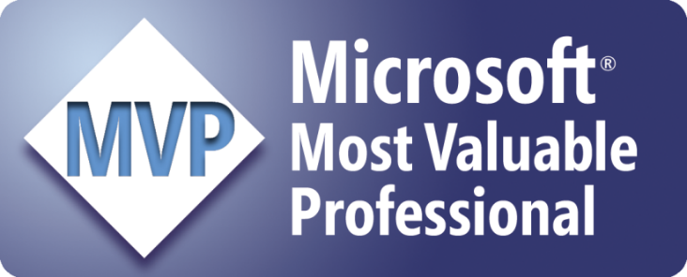
Etienne Tremblay
Etienne Tremblay
Twitter: @tegaaa
Email: etiennet@imaginet.com
ALM MVP
ALM Chapter Leader MSDevMtl User group

Slide 4
Your service
Notes:
Slide Objectives:
Explain how Azure helps developers to refocus on their applications.
Speaker Notes:
Before we discuss about specifics, let’s refocus on what you care about – your application/service.
Azure is taking a application-centric approach and brings tools and services to support DevOps scenarios.

Slide 5
→ Your application code
→ Your infrastructure code
→ Required resources
Notes:
Slide Objectives:
Explain application is made up by application code and infrastructure code.
Speaker Notes:
Let’s start with something that you know inside-and-out: your application code. [click]
Then, for whatever reason, you decide to deploy your application to Azure. [click]
What you do is to allocate a bunch of related resources out of the humongous resource pool provided by Azure, deploy your application code to these resources, and you have a running service. [click]
For DevOps’ perspective, you need a way to reliable capture and apply your requirements on resources, which can be referred as infrastructure code.

Slide 6

You: Code (application, infrastructure)
Azure: Resources (IaaS, PaaS, SaaS)
Notes:
Slide Objectives:
Reiterate the point that to make your service successful, you are partnering with Azure. You bring the code, and Azure brings resources.
This slide also sets state for the talk by explaining how IaaS components fit into the overall picture.
Speaker Notes:
[Continue with previous slide]
To make your service successful, you are partnering with Azure. You bring the code, and Azure brings resources. [Click]
And you keep iterating and making improvements over time. [Click]
In terms of infrastructure code, you can use it to define desired states of required resources (Note: current Azure Resource Manager only support a small number of Resource Providers). [Click]
You can define hosting environments, such as websites, cloud services and VMs. [Click]
Required services. [Click]
In this session we’ll focus on infrastructural components including virtual machines and virtual networks.

Slide 7
Virtual Machines

Slide 8
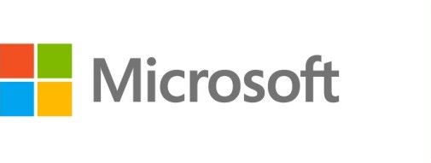



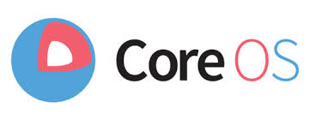

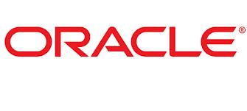
Azure Virtual Machines
Launch Windows Server and Linux in minutes
Scale from 1 to 1000s of VM Instances
Save money with per-minute billing
Open and extensible
Notes:
Slide Objectives:
High-level selling points of virtual machines.
Speaker Notes:
Both Linux and Windows are supported. It’s important to reiterate on this as many developers are still not aware of this.
Mention scaling at enterprise level using DSC, Puppet or Chef.
Emphasize on the openness – we are not forcing your to lock on Microsoft technologies. Instead, Azure is more open than ever. You can leverage your existing skills, tools and services, and Azure is providing more and more first-class supports for them.

Slide 9


Provisioning VM
Getting Started
Select Image and VM Size
New Disk Persisted in Storage
Windows Server
Management Portals
Boot VM from New Disk
Linux
>_
General Purpose
Basic
Standard
Optimized Compute
Performance Optimized
Network Optimized
Scripting
(Windows, Linux and Mac)
Cloud
REST API
Notes:
Slide Objective:
Explain workflow for provisioning VMs in the cloud
Speaker Notes:
You have three methods of starting this process: Build a VM from the portal, from the command line OR programmatically calling the REST API.
Once your choice of provisioning is made you will need to select the image and instance size to start from.
The newly created disk will be stored in blob storage and your machine will boot.

Slide 10
New ways to create VMs
Visual Studio – Resource Manager Templates
Azure Automation
Azure Website – Git Hub

Slide 11






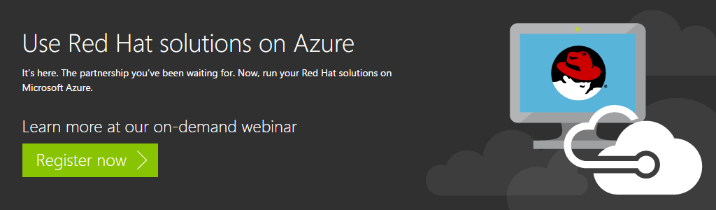



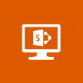







VM Gallery
A collection of prebuilt images for various workloads
Windows Server 2012 R2
Ubuntu Server 14.04 LTS
CentOS 6.5
SUSE Linux
Enterprise Server
openSUSE 13.1
Oracle Linux 6.4.0.0.0
SQL Server 2014 Standard
Oracle Database 11g R2
SharePoint Server Farm
Microsoft Dynamics
GP 2013
Zulu 8
BizTalk Server 2013
SAP HANA
Developer Edition
Puppet Enterprise 3.2.3
Barracuda Web Application
Oracle WebLogic
Server 12.1.2
Visual Studio Ultimate 2013
Windows 8.1 Enterprise
Notes:
Slide Objective:
Explain a wide variety of images that you can choose from.
Speaker Notes:
First of all, you can choose from different Windows Servers and a variety of Linux implementations. [Click]
As well as pre-built images for different flavors of SQL Database and Oracle databases. [Click]
You can also choose from a number of first-party and certified third-party images for various application servers and infrastructural components. [Click]
And last but not least, if you are a MSDN subscriber, you also have access to Visual Studio images and client Windows systems such as Windows 7 and Windows 8.1 for your DevTest purposes.

Slide 12
Virtual Machine Sizes
General Purpose compute: Basic
General Purpose compute: Standard
Optimized Compute
Performance Optimized
Network Optimized
Notes:
Slide Objective:
Introduce different virtual machine sizes.
Speaker Notes:
http://azure.microsoft.com/en-us/pricing/details/virtual-machines/

Slide 13
Scale-up options
Highest value
Largest scale-up
A
D
G
N
DV2
Highest value
Most memory fastest CPUs
GPU-enabled virtual machines
SSD Storage Fast CPUs
>80,000 IOPs
Premium Storage
New generation of D family VMs
35% faster than D
Intel E5-2673 v3 CPUs
NVIDIA GPUs
Remote visualization
Compute-intensive + RDMA
Largest virtual machines Fastest storage in the public cloud

Slide 14
General Purpose Compute
Multiple Tiers
Tier | Instance | Cores | Ram | Disks | Features
Basic | A0-A4 | 1-8 | 0.75 to 14 Gb | 20-40 Gb | Economy, No Auto Scaling, no Load balancing
Standard | A0-A3 | 1-4 | 0.75 to 7 Gb | 20-285 Gb | All VM features and configurations
Standard | A4-A7 | 2-8 | 14-56 | 135-605 Gb | All VM features and configurations
Standard | A8-A9 | 8,16 | 56,112 | 382 Gb | Infiniband, RDMA. Clustering, Video encoding
Optimized Compute (D Tier) | D1-D4, D11-D14 | 1-16 | 3.5 - 112 | 50-800 Gb | 60% faster CPUs, more memory, and local SSD
Performance Optimized Compute (G Tier) | G1-G5 | 2-32 | 28-448 | 384Gb-6.1Tb | Unparalleled computational performance with latest CPUs, more memory, and more local SSD

Slide 15
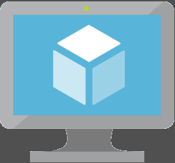
Key Improvements: Azure Virtual Machines (v2)
Massive and parallel deployment of Virtual Machines
3 Fault Domains in Availability Sets
Custom URLs for Custom Script VM Extensions for VMs
https://azure.microsoft.com/en-us/documentation/articles/virtual-machines-app-frameworks/

Slide 16
NEW: VM Scale Sets

Slide 17
What are Virtual Machine Scale Sets?
A way to deploy and manage VMs as a set
Integrated with Azure Autoscale
Integrated with Azure Load Balancer
An Azure Compute resource Microsoft.Compute/virtualMachineScaleSets
A scalable compute platform
A platform independent infrastructure for PaaS
Base OS Image
Scalable VM
Scalable VM
Scalable VM
Scalable VM
Scalable Virtual Machine
Extension 1
Extension 1
Agent
Extension 1
Extension 2
Agent
Extension 1
Extension 2
Agent
Extension 1
Agent
Extension 2
OS Image Diff
Agent
Extension 2
OS Image Diff
Extension 2
OS Image Diff
OS Image Diff
OS Image Diff Disk
Notes:
Pets vs Pack – cattle.

Slide 18
VMs + Containers

Slide 19
Containers
App
A
App
A
App
B
What are they?
Unit of deployment
Isolated environment
Isolated collection of resources
What are the benefits?
Instant startup
Repeatable and reliable execution
Scenarios
Dev/Test
Great for micro-services
App
Framework
App
Framework
App
Framework
VM
Host OS
Guest OS
Guest OS
Guest OS
Hypervisor
Physical Server
App
A
App
A
App
B
App
B
App
B
Container
Container Manager
App
Framework
App
Framework
Host OS
Physical Server
Notes:
When you see “containers” you probably think of Docker. For good reason, Docker has essentially defined the container market. To understand what Docker is let’s start by looking at Containers.
Containers are an isolated environment and isolated collection of resources that an application runs in. The resources are all the dependencies (DLL’s, configuration, etc.) that the application needs. Everything the application needs to run is in the container and it sees nothing on the host OS it is running on (except maybe an internet connection). Containers are therefore a unit of deployment.
<click>
A key benefit of containers is that they can startup almost instantly. The notion of “booting up” a guest OS doesn’t exist. The container just runs on top of the host OS. As a result, containers can startup almost instantly as compared to the startup period of a VM. And because everything is contained in this container, containers are easily repeatable and extremely reliable from one environment to the next. For example, I can run a container on my local dev box and have high confidence it will run the same when deployed to another machine, such as a VM running in Azure.
<Click>
As you can probably imagine, containers are extremely popular in dev/test scenarios. They are also great for micro-services.
<click>
To put a visual behind this, consider the architecture for a typical virtual machine. You have a physical server, hyper-visor and host OS. Then, each VM has it’s own guest OS that can be configured with applications and application frameworks. This is what you saw earlier in the presentation.
<click>
Now consider how a container is different. Physical Server with a host OS. However, notice there is not a guest OS. The container is essentially the application and it’s dependencies. Also notice that the app frameworks used by application A and application B are shared in this model. This is how instant startup is achieved.
Note that there are more instances of the same App running on the physical server. This underlines that a container is a scale unit besides being an isolation mechanism. In a production development you would use a cluster of hosts, and have containers spread of the hosts.

Slide 20


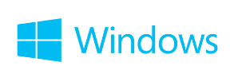
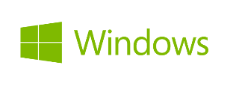
Container Ecosystem via Docker
Container Run-Time
Container Images
Image Repository
Linux
Docker API / Client
Docker images
Docker Hub
(trusted repositories)
Notes:
Docker has also pretty-much defined the container ecosystem (de-facto standard). It provides the means for deploying these containers and resources onto a machine by developing a Docker API that drives these activities.
The container runtime traditionally only ran on Linux VM’s. However, today, Windows Server 2016 provides a new “Container Role” (similar to other roles like AD, File Server, etc.) that you can configure on Windows. This provides the same abilities to create and manage containers that exists on Linux.
<Click>
Docker has also become the standard for defining what a container image looks like. The file format, the manifest that goes into the container, and how image dependencies are configured. And Windows and .NET are perfectly valid candidates for a Docker image.
<Click>
Docker has become the standard place for people to publish their images. Docker Hub is a public “trusted repository” where you can find literally thousands of Docker images such as Apache, MySQL, and even .NET.
Microsoft Azure embraces this container technology and has integrated it directly into the platform.

Slide 21
Managing VMs using the Azure portal
http://portal.azure.com

Slide 22
Managing VMs using the Azure PowerShell
# Create Virtual Machine
New-AzureRmVM -ResourceGroupName $RGName -Location $Location -VM $AzureVM

Slide 23
Image Mobility
On-Premises
Cloud
MyApp.vhd
Notes:
Slide Objective:
Explain the benefits of image mobility
Notes:
One of the key benefits of IaaS is flexibility and control. The Microsoft Azure solution provides the capability of not only moving VHDs TO the cloud but also allows you to copy the VHD back down and run it locally or on another cloud provider. Great for testing out production issues or any other need where you require a copy of the production server.

Slide 24

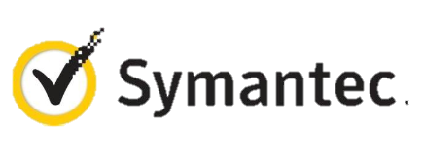




VM Extensions
Installable components to customize VM instances
Enable various DevOps scenarios
Can be added, updated, disabled or removed at any time
Managed via portal, PowerShell and Management APIs
Microsoft Azure
Notes:
Slide Objective:
Introduce VM extensions.
Speaker Notes:
No matter how big the image gallery is, your projects may have specific needs that can’t be satisfied by standard images.
Some components such as anti-virus, configuration management agents are required on most machines for compliance and management purposes.
This allows use to innovate faster to meet with your project needs. And you have flexibility to pick and combine extensions for your goals.
Point out some of existing extensions:
Custom Script Extension, which allows you to download and execute PowerShell scripts.
Chef Extension and Puppet Extension for automated management at scale.
Symantec Endpoint Protection etc. for protection.
Docker (Linux only).
Visual Studio Remote Debugger.

Slide 25
Add an extension to a VM instance
# Set new extension to the VM
Set-AzureRmVMCustomScriptExtension –ResourceGroupName $RGName –VMName $VMName -Name "HelloWorld" -Location $Location -TypeHandlerVersion "1.8" -FileName "HelloWorld.ps1" -ContainerName scripts -StorageAccountName $SAName -StorageAccountKey $SAkey1 -Run "HelloWorld.ps1"

Slide 26
Data Persistence
Data Disks
Azure Files

Slide 27
Disks and Images
OS Images
Microsoft
Partner
User
Base OS image for new Virtual Machines
Sys-Prepped/Generalized/Read Only
Created by uploading or by capture
Disks
OS Disks
Data Disks
Writable Disks for Virtual Machines
Created during VM creation or during upload of existing VHDs.
Notes:
Slide Objective:
Explain the differences between disks and images with VMs

Slide 28
Azure Files
Shared Network File Storage for Azure
Availability, durability, scalability are managed automatically
Supports two interfaces: SMB and REST
IaaS VM
IaaS VM
IaaS VM
PaaS VM
Azure File Share
(PaaS)

Slide 29
Azure Files Scenarios
Share data across VMs and applications
Multiple writers, multiple readers using standard file system semantics.
Share settings throughout services
VMs can read settings and files from a common, shared location. These can be updated externally via REST.
Dev/Test/Debug
Very useful to have a shared location for installing applications, setting up VMs, running tools, and keeping notes while developing, testing, and debugging cloud services.

Slide 30
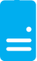
Persistent Disks and Highly Durable
Microsoft Azure Storage (Disaster Recovery)
Microsoft Azure Storage
Virtual
Machine
Virtual Machine
Notes:
Slide Objective:
Explain how disks are durable and how Microsoft Azure storage works
Notes:
The OS and Data Disks are stored in Microsoft Azure storage. So in addition to the data being persistent you also get the benefits of storage which means your VHD is replicated 3X’s locally and also 3X’s in a separate data center in the same region (geo-replication)

Slide 31
Linux on the
Microsoft Cloud Platform

Slide 32
Microsoft Linux

Slide 33
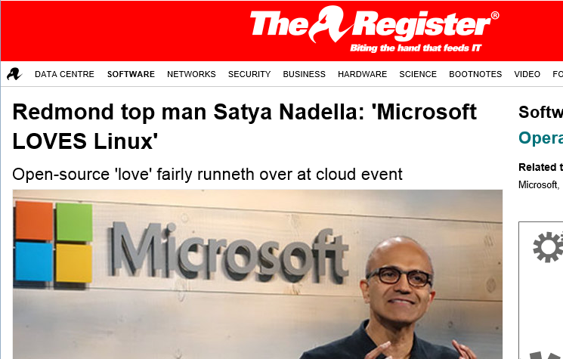
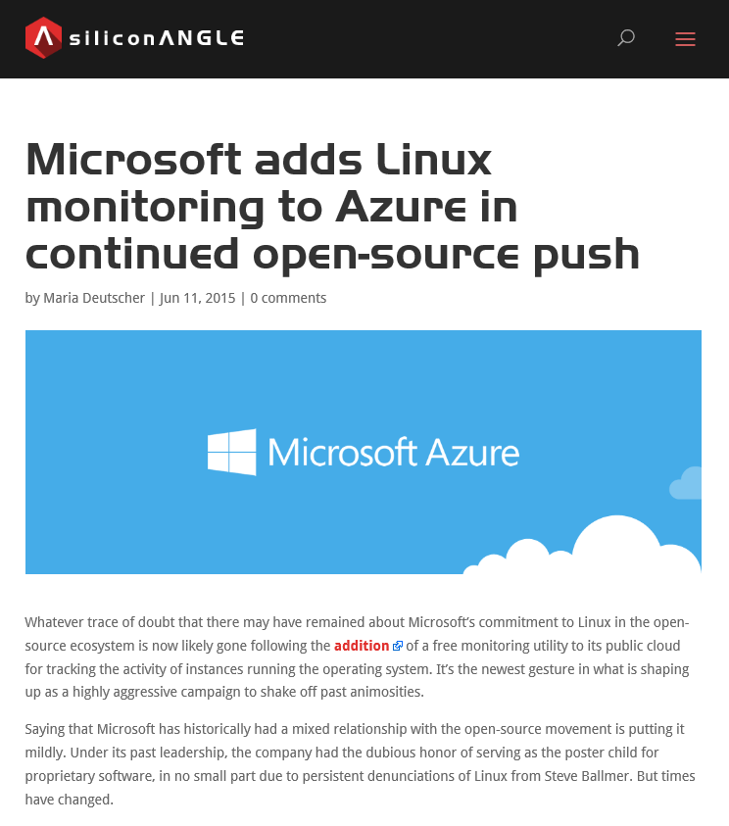
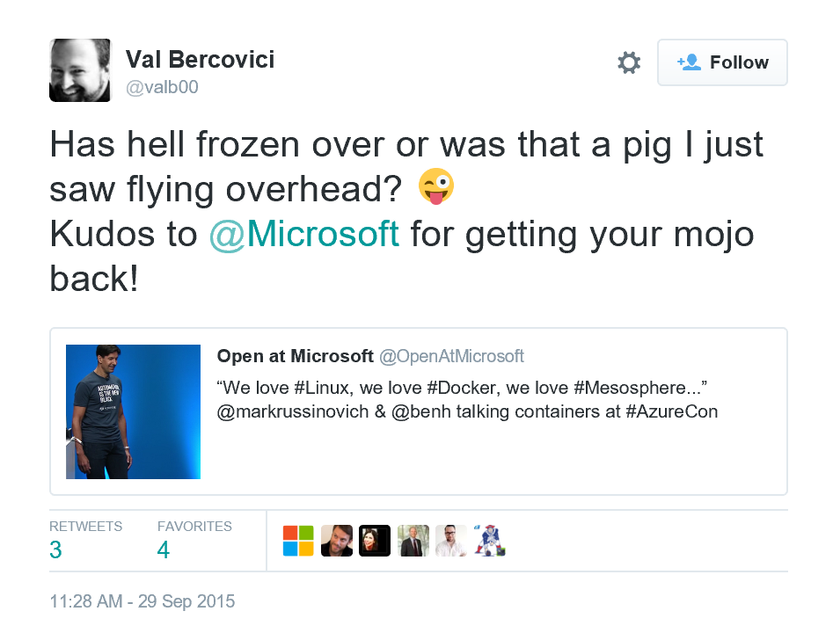
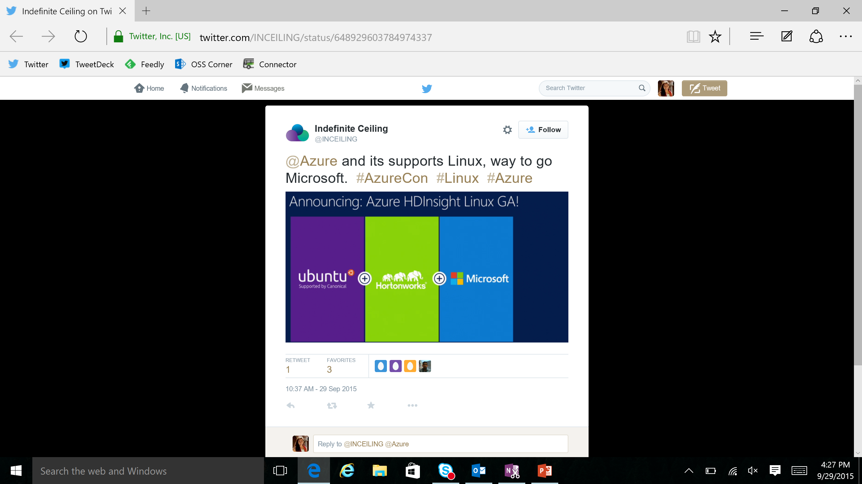
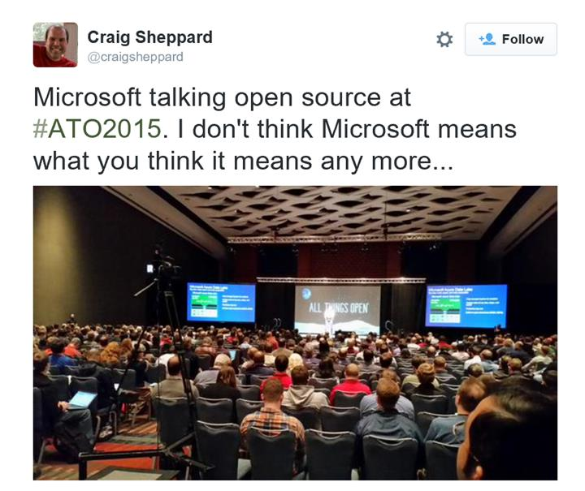
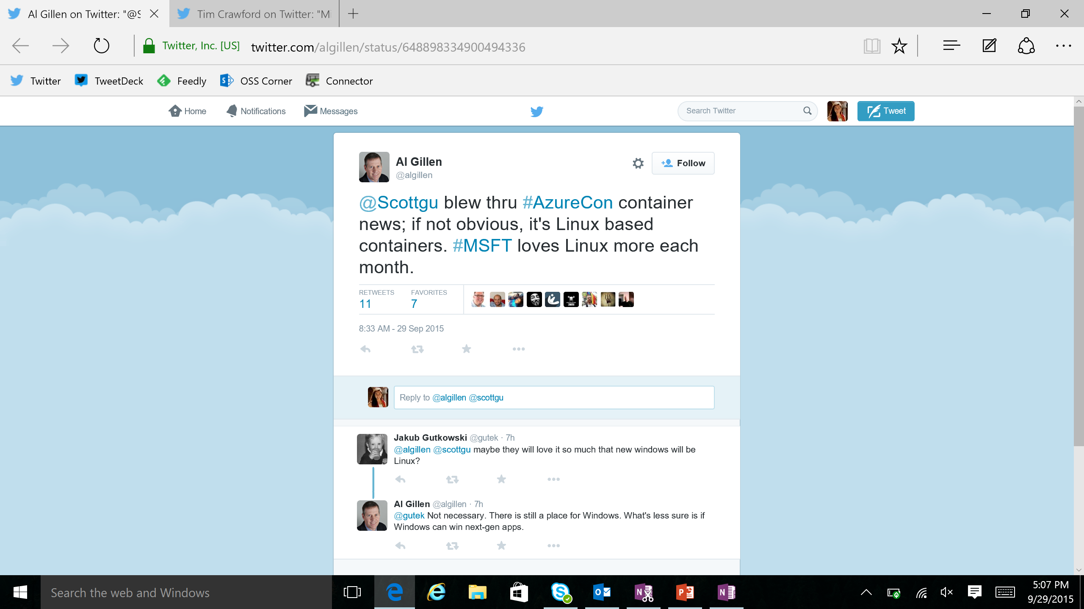

Slide 34
Microsoft is committed to Linux and open source
Linux is a real business for Microsoft
25% of IaaS VMs in Azure are Linux
System Center manages hundreds of thousands of Linux/UNIX servers
Many enterprises and service providers
run Linux as a guest on Hyper-V
… and we’re been in a long open source journey!
System Center has managed Linux and
UNIX servers since 2009
Linux drivers for Hyper-V available since 2010
Azure IaaS has run
Linux VMs since
“day 1” in 2013
Linux and open source are a fundamental part of how we do business
Today

Slide 35
Virtual Machine Availability
Meaning of 9’s
Fault domains, update domains and availability sets
Load balancing

Slide 36
Meaning of 9’s
Service Availability(%) | System Type | Annualized Down Minutes | Quarterly Down Minutes | Monthly Down Minutes | Practical Meaning | FAA rating
90 | Unmanaged | 52,596.00 | 13,149.00 | 4,383.00 | Down 5 weeks per year
99 | Managed | 5,259.60 | 1,314.90 | 438.30 | Down 4 days per year | ROUTINE
99.9 | Well managed | 525.96 | 131.49 | 43.83 | Down 9 hours per year | ESSENTIAL
99.99 | Fault tolerant | 52.60 | 13.15 | 4.38 | Down 1 hour per year
From Generic Requirements for Operation Systems Platform Reliability, Telcordia Technologies System Documentation,GR-2841-CORE and
Federation Aviation Administration Handbook: Reliability, Maintainability, and Availability (RMA) Handbook, FAA-HDBK-006A, Jan 7, 2008.
Microsoft Azure

Slide 37
Meaning of 9’s
Service Availability(%) | System Type | Annualized Down Minutes | Quarterly Down Minutes | Monthly Down Minutes | Practical Meaning | FAA rating
99.999 | High availability | 5.26 | 1.31 | 0.44 | Down 5 minutes per year | CRITICAL
99.9999 | Very high availability | 0.53 | 0.13 | 0.04 | Down 30 seconds per year
99.99999 | Ultra availability | 0.05 | 0.01 | - | Down 3 seconds per year | SAFETY CRITICAL
From Generic Requirements for Operation Systems Platform Reliability, Telcordia Technologies System Documentation,GR-2841-CORE and
Federation Aviation Administration Handbook: Reliability, Maintainability, and Availability (RMA) Handbook, FAA-HDBK-006A, Jan 7, 2008.
Microsoft Azure

Slide 38

Service Level Agreements
99.95% for multiple role instances
4.38 hours of downtime per year
What’s included
Compute Hardware failure (disk, CPU, memory)
Datacenter failures - Network failure, power failure
Hardware upgrades, Software maintenance – Host OS Updates
What is not included
VM Container crashes, Guest OS Updates

Slide 39
Virtual Networks

Slide 40
Azure Virtual Networks
A protected private virtual network in cloud
Extend enterprise networks into Azure
Cross-premises connectivity

Slide 41
Virtual Network Scenarios
Hybrid Public/Private Cloud
Enterprise app in Microsoft Azure requiring connectivity to on-premise resources
Enterprise Identity and Access Control
Manage identity and access control with on-premise resources (on-premises Active Directory)
Monitoring and Management
Remote monitoring and trouble-shooting of resources running in Azure
Advanced Connectivity Requirements
Cloud deployments requiring IP addresses and direct connectivity across services
Microsoft Azure

Slide 42






Cross-premises Connectivity
Site-to-site
Create a secure connection between your on-premises site and your virtual network
Point-to-site
Create a secure connection via VPN to your virtual network
ExpressRouteTM
Create a private connection between Azure data centers and infrastructures on your premises or in a co-location environment.
Connect at an ExpressRoute location (Exchange Provider facility)
Direct connect via a Network Service Provider
Microsoft Azure

Slide 43
Load balancing
Load balancing
Multiple VMs share the workload via public facing endpoints
Internal Load balancing
Load balancing between VMs that don’t have public facing endpoints
Microsoft Azure
Internet
Public VIP
Customer vNet
External Load Balancer
Internal Load Balancer
Microsoft Azure
Back end
Front end

Slide 44
Traffic Manager
Load balancing
Failover
Performance
Round-Robin
Geo distribution
US West
North Europe
Microsoft Azure
North America
Europe
Notes:
Traffic Manager profiles created using the existing (non-ARM) Azure Service Management (ASM) API, tools and 'classic' portal are not available via ARM, and vice versa. Migration of profiles from ASM to ARM APIs is not currently supported, other than by deleting and re-creating the profile.
'Nested' Traffic Manager endpoints are supported via the ARM API, ARM PowerShell and ARM-mode Azure CLI. They are not currently supported in the Azure portal (which also uses the ARM API).
Traffic Manager endpoints of type 'AzureEndpoints', when referencing a Web App, can only reference the default (production) Web App slot. Custom slots are not yet supported. As a workaround, custom slots can be configured using the 'ExternalEndpoints' type.

Slide 45
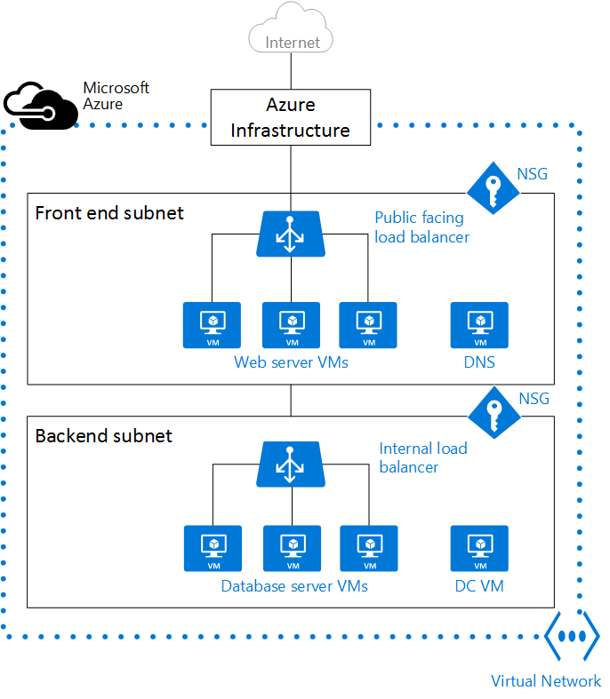
Network Security Groups
Access control List (ACL) rules that allow\deny network traffic to your VM instances in a Virtual Network.
Can be associated with either subnets or individual VM instances within that subnet

Slide 46
Azure Resource Manager

Slide 47
Azure Resource Manager & Resource Groups
Manage resources as a single unit
Role based access and control (RBAC) on groups or resources
Billing integrated tagging on groups or resources
RESOU
R
CE G
R
OUP

Slide 48



Azure Resource Manager (ARM)
This slide could use build/animation. It builds from top to bottom. Azure/Commandline/Visual studio all hit the API to interact with resource manager groups which in turn interact with the different rest points. The link https://azure.microsoft.com/en-us/documentation/articles/virtual-machines-azure-resource-manager-architecture/
explains what this slide is supposed to get across.
RESOURCE MANAGER
Consistent management layer
Tools
SERVICE MANAGEMENT API
Microsoft Azure
Command line
Visual Studio
ADFS
AAD
Contoso
Curated extensions
Cloud
On-premises
RESOURCE PROVIDER CONRACT
Provider rest points
DB

Slide 49
Azure Resource Manager Templates
Azure Templates can:
Ensure Idempotency
Simplify Orchestration
Provide Cross-Resource Configuration and Update Support
Azure Templates are:
Source file, checked-in
Specifies resources and dependencies (VMs, WebApps, DBs) and connections (config, LB sets)
Parametrized input/output
SQL-A
Website
Instantiation of repeatable config.
Configuration → Resource Group
[SQL CONFIG] VM (2x)
DEPENDS ON SQL
DEPENDS ON SQL
SQL - A
Website
Virtual
Machines
SQL
CONFIG
Microsoft Azure

Slide 50
Management models for IaaS
Classic Model (v1)
Resource Manager (V2)
Cloud Service
Resource Group
Load Balancer w/ IP Address
Backend Pool (NICs)
VM w/ IP Address
Storage Account
VM
NIC
VM IP Address
VNet
Load Balancer
VM IP Address
Subnet
Disk (blob)
Reference
Reference
Reference
Storage Account
Virtual Network
DependsOn
Reference
Reference
Disk (blob)
Subnet-1
Network Security Group

Slide 51
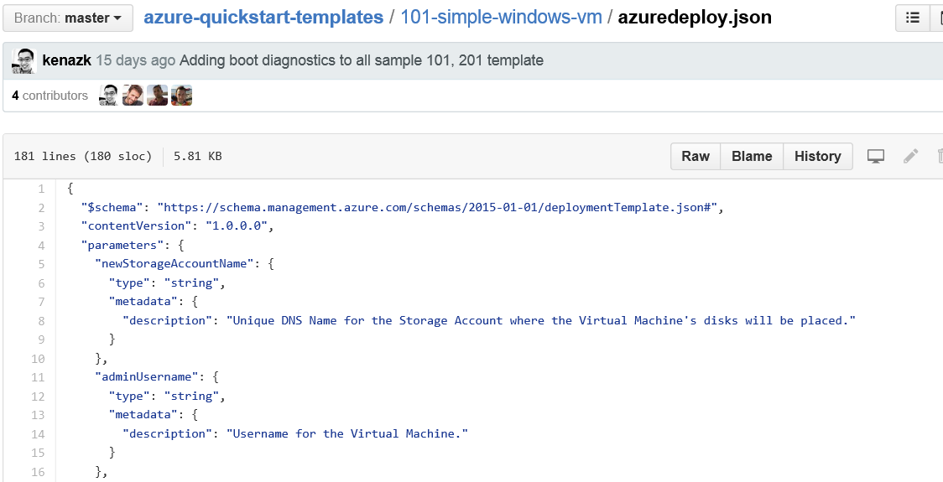
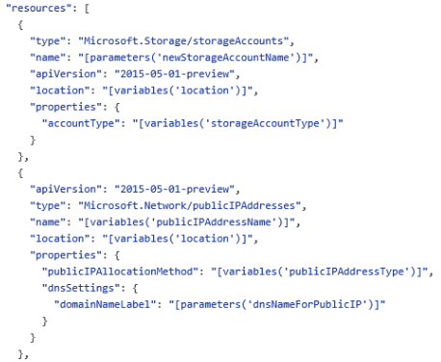
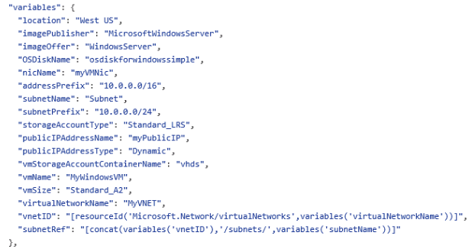
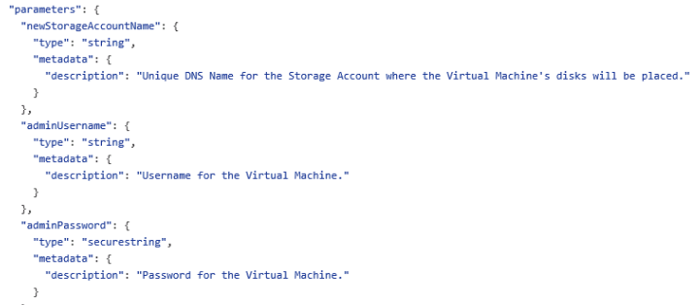
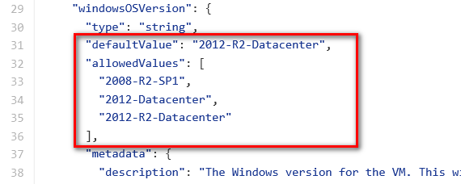
JSON files—simpler than they look Schema, content version, parameters, variables, resources, and outputs

Slide 52
ARM Demo on GitHub
https://github.com/Azure/azure-quickstart-templates
A simple VM as code in GitHub
Deploy to Azure
Visualize

Slide 53
ARM Demo from Visual Studio
Visual Studio with the Azure SDK 2.8+
A simple VM as code from Visual Studio
A scaled set template demo
Add dsc extension demo

Slide 54

Q&A

Slide 55


Get started
Visit azure.microsoft.com

